Slide 1
Module-1
Introduction And Basic Information About Indian Constitution
Dr.P.DEVI

Slide 2
Introduction
Every state must have a Constitution. Without a constitution it is difficult to govern a state.
History tells that since the origin of the state there had been some kinds of rules and regulations in some form to maintain the order and harmony in the state.
In every state be it a democratic or despotic it is essential that such rules must be accepted which would decide the role and organization of political institutions in order to save the society from anarchy.
In modern states these rules find expression in the form of a constitution.

Slide 3
Definition
A document containing laws and rules which determine and describe the form of the government, the relationship between the citizens and the government is called a constitution.

Slide 4
Meaning
The Constitution of India is the supreme law of India. It frames fundamental political principles, procedures, practices, rights, powers, and duties of the government.
It imparts constitutional supremacy and not parliamentary supremacy, as it is not created by the Parliament but, by a constituent assembly, and adopted by its people, with a declaration in its preamble. Parliament cannot override it.

Slide 5
Meaning
The constitution contains laws concerning the government and its relations with the people. A constitution is concerned with 2 main aspects:-
a) The relation between the different levels of government and
b) Between the government and the citizens.

Slide 6
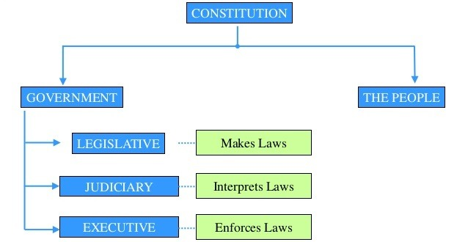

Slide 7
Meaning
On the basis of above definitions we can say that a constitution is
The fundamental law of the land
May be written or unwritten
Deals with the composition and power of the government.
Deals with the rights of citizens.
Deals with the relationship between the government and governed.
It is supreme law that must be followed

Slide 8
Need for constitution
1. To curb the powers of the government by fundamental law.
2. To protect the rights of individuals
3. To establish the principle of ‘rule of law’.
4. To save the state from anarchy.
5. To define the operation of the sovereign power of the state.
6. To limit the vagaries of present and future generations.

Slide 9
] CONTENTS OF THE CONSTITUTION
A constitution must have the following provisions in it
1. Organization and form of administration of the state
2. Functions of different organs of the government their powers and mutual relations.
3. Mention of fundamental rights of the citizens
4. The relation of the government with the people.
5. The procedure of the government of the constitution

Slide 10
Constitution Vs Constitutionalism
CONSTITUTION | CONSTITUTIONALISM
A document that limits the powers of the state. | The concept/ theory/ ideology behind limiting the powers of the state.
Written document. | Soul/ philosophy of the constitution- unwritten.
Deals with the structure of the government, political processes, and rights of the citizen. | Deals with limiting the powers of the state and protecting individual rights.
Set rules and standards to distribute benefits and burdens in a society. | Application of the laws in achieving those goals.

Slide 11
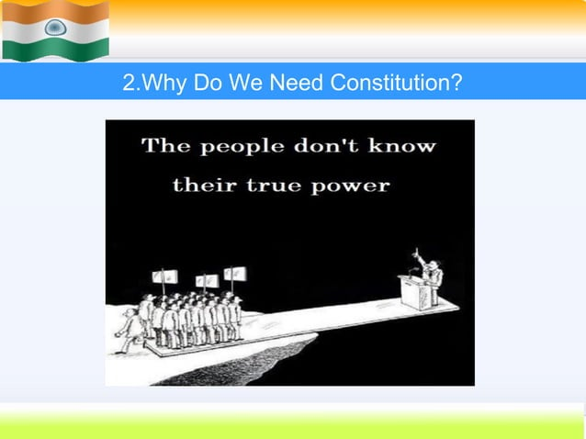

Slide 12
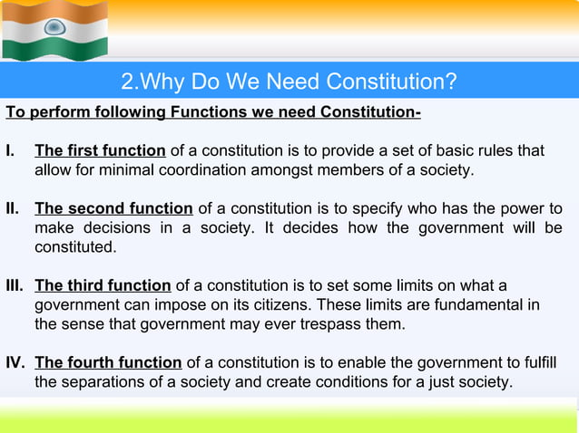

Slide 13
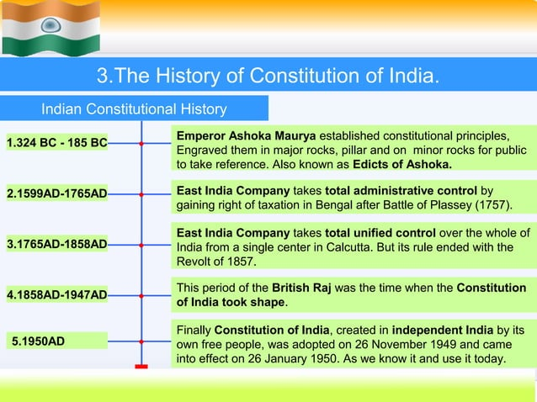

Slide 14
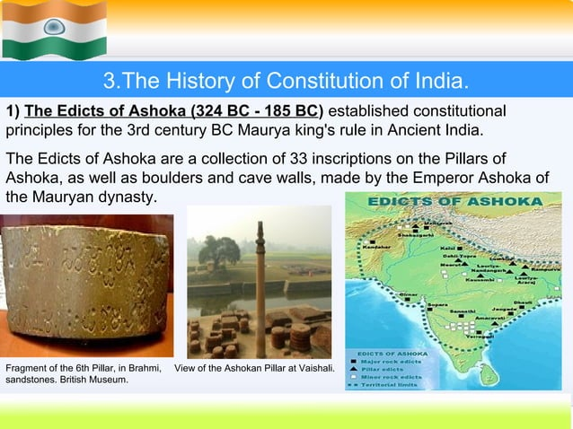

Slide 15
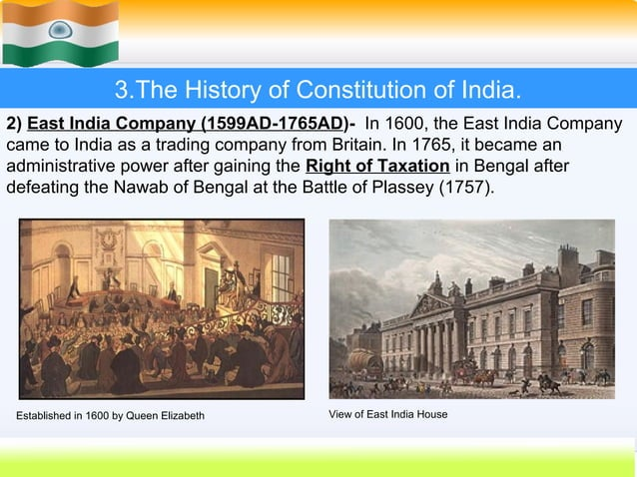

Slide 16
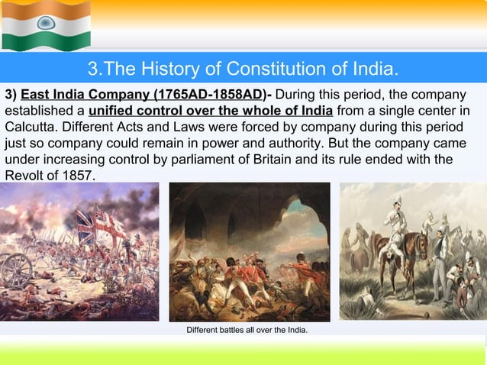

Slide 17
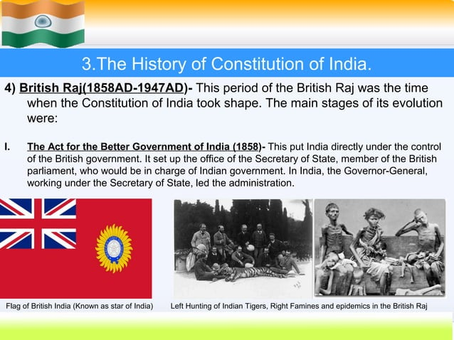

Slide 18
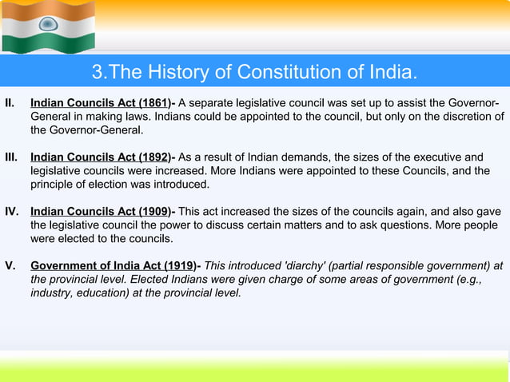

Slide 19
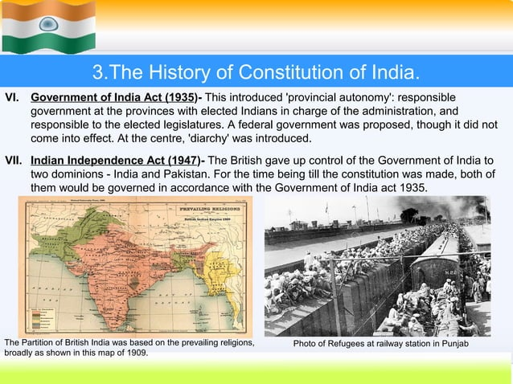

Slide 20
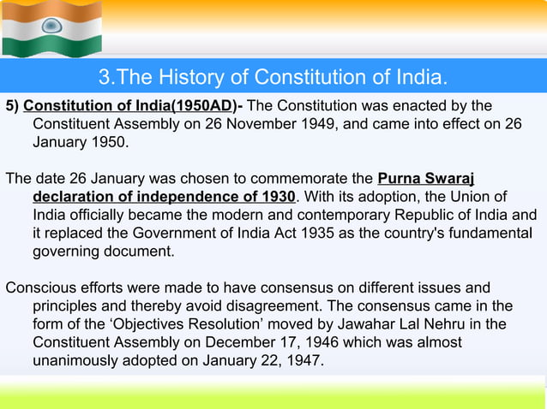

Slide 21
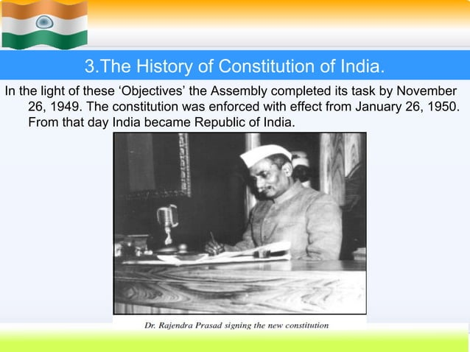

Slide 22
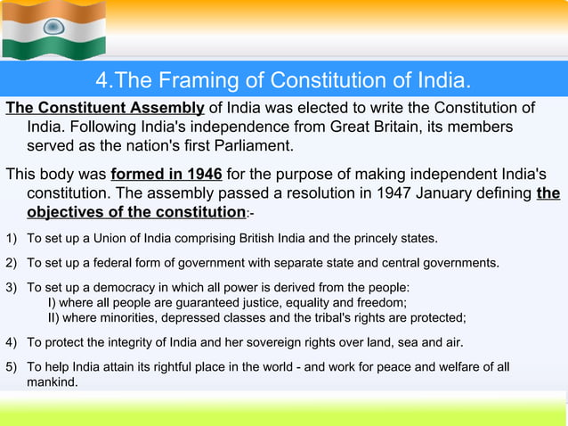

Slide 23
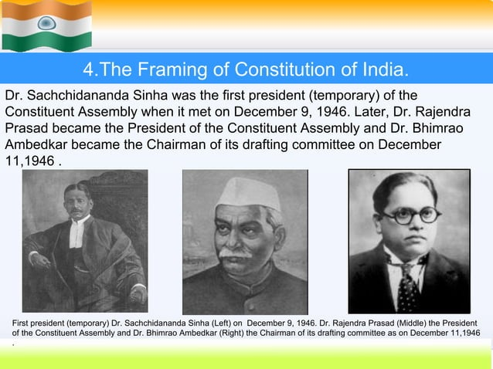

Slide 24
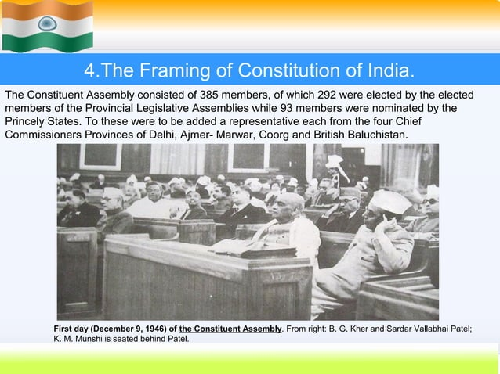

Slide 25
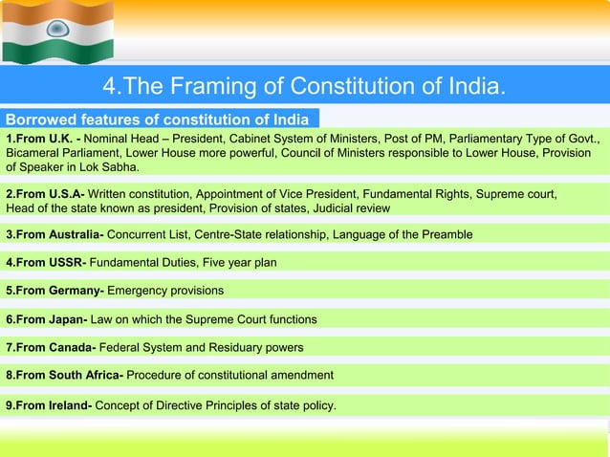

Slide 26
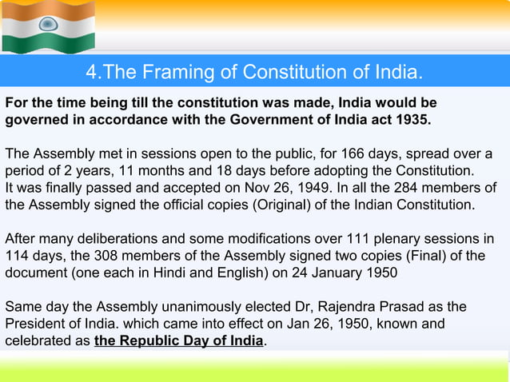

Slide 27
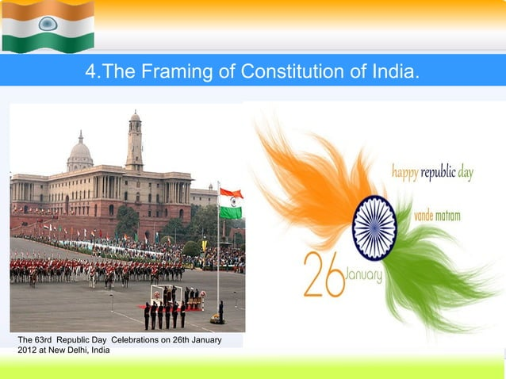

Slide 28
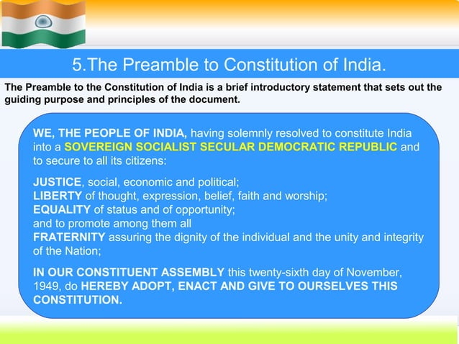

Slide 29
